Slide 1
An Efficient Index for Computation of Approximate Nearest Neighbors with Query Specified Dimension Relevance Weights
by
David Katz
Advisor:
Carl Sable

Slide 2
Table of Contents
Nearest Neighbors and its Applications
Motivation for Our Index
Basic Overview of Existing ANN Indexes
Detailed Overview of k-d trees
System Description of Our Index
Performance Results
Future Work

Slide 3
1. Nearest Neighbors and its Applications

Slide 4
Vector Space Model
Model real world entities as vectors with various features
Features normalized proportional to importance
Movies
Tag Genome data set
Image
Corel Image data set
Tumor
Wisconsin Breast Cancer data set
Document
Bag of words model

Slide 5
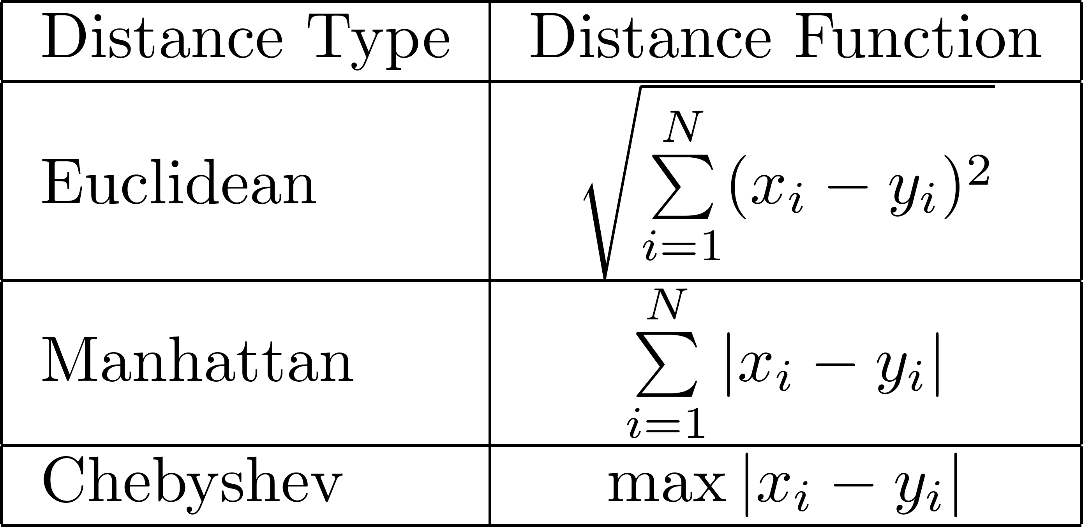
Distance metrics

Slide 6
Basic Nearest Neighbor Search Algorithm
Inputs
Set of N points
Query point
Linear search
Compute the distance between query point and all points in a vector space
Keep track of the current closest point
O(N) complexity per query

Slide 7
Nearest Neighbor Variants
K nearest neighbors (KNN)
Find the K closest elements to a point
Can be applied towards classification on labeled datasets
Retrieve similar entities for recommendation systems or information retrieval
Fixed radius search
Important in graphics and computer vision
Ex: Lagrangian simulation, computational geometry, point cloud problems

Slide 8
Extension to KNN
Store top K elements in a max heap
O(1) find-max
O(log(K)) delete-max
O(log(K)) insert (O(1) average case)
Insert first K elements into the heap
If a point’s distance is closer than the current max:
Perform delete-max
Insert the new point
Overall complexity of KNN query: O(Nlog(K))

Slide 9
Extension to Fixed Radius Search
Add all points whose distance is less than R to the result set
O(N) complexity per query
Size of result set unknown at start of query

Slide 10
Approximate Nearest Neighbors
No algorithm can find exact nearest neighbors in sub-linear time for high dimensional vector spaces
Many applications do not require the exact set of closest points
Recommendation systems
Information retrieval
Computer vision
Construct an index on the data set to search it in a more effectively

Slide 11
2. Motivation for Our Index

Slide 12
Query Specified Dimension Relevance
Specify a Dimension Relevance Vector (DRV) at query time
DRV contains information of how important each dimension is
Normalize sum of DRV to 1
Transform space by multiplying each dimension by D and its weight in the DRV
Conventional indexes do not support these types of transformations at query time
Has potential applications in recommendation and information retrieval

Slide 13
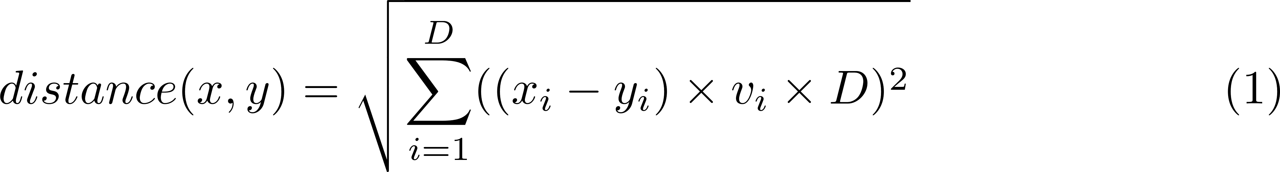
Modified Distance Metric
Equivalent to Euclidean distance when all dimensions are weighted equally

Slide 14
3. Basic Overview of Existing ANN Indexes

Slide 15
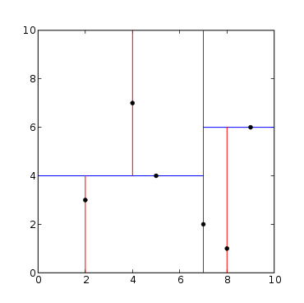
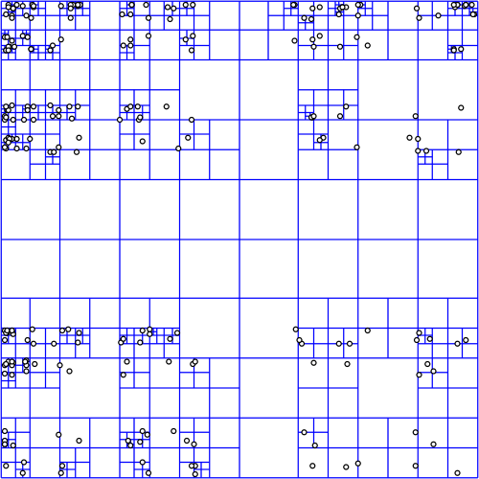
Tree Indexes
Partition points into sub regions
Search nearby sub regions first
http://en.wikipedia.org/wiki/K-d_tree
http://commons.wikimedia.org/wiki/File:Point_quadtree.svg

Slide 16
Tree Indexes
Advantages
Disadvantages
Best performance on low dimensional spaces
Quality of results proportional to amount searched
O(Nlog(N)) construction
Easily modifiable
Do not scale well to high dimensional spaces
High theoretical worst case performance

Slide 17
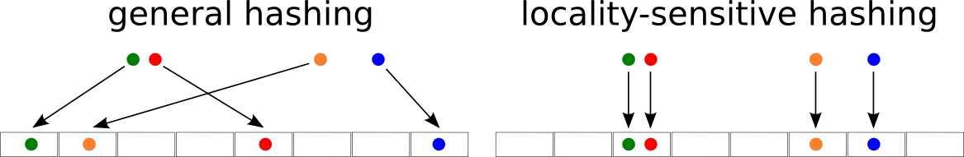
Hash indexes
Use hash functions which put similar points in the same bucket with a high probability
http://0110.be/Software

Slide 18
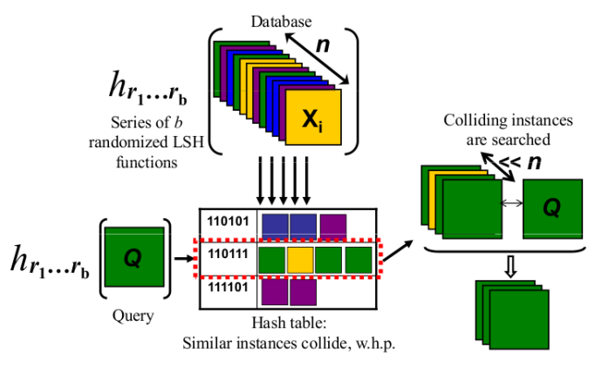
Hash Indexes
Points with a high number of collisions are considered to be close
http://micvog.com/2013/09/08/storm-first-story-detection/

Slide 19
Hash Indexes
Advantages
Disadvantages
Scales well to high dimensional spaces
Variety of different types of hash functions can be applied
Linear construction
Easily modifiable
High constant factor in memory consumption
Quality of search results constrained by number of hash functions

Slide 20
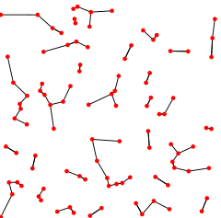
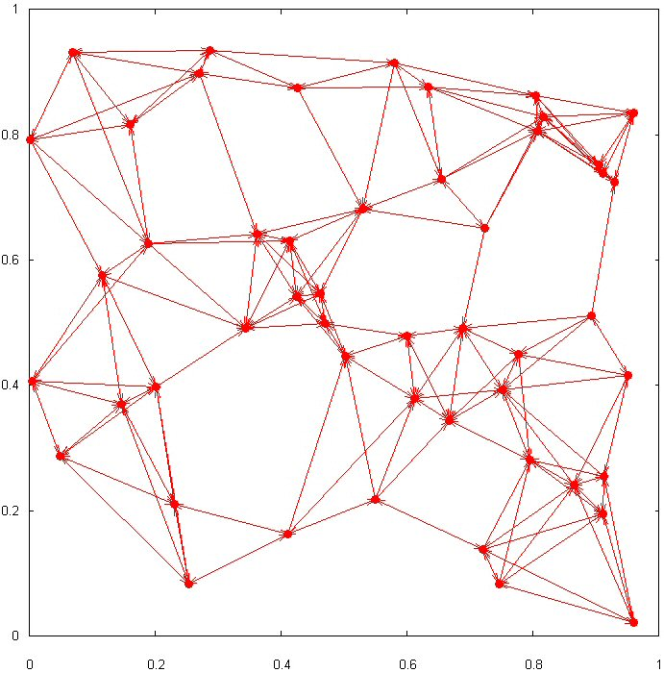
Graph Indexes
http://en.wikipedia.org/wiki/Nearest_neighbor_graph
http://www.maths.dur.ac.uk/users/andrew.wade/research/graphs.html

Slide 21
Advantages
Graph Indexes
Disadvantages
Extremely fast queries
O(KN) memory consumption
Top performance in certain datasets
Result quality proportional to amount searched
High offline computational cost
High amount of randomness in queries
Distance metric precomputed
Expensive to modify

Slide 22
4. Detailed Overview of k-d Trees

Slide 23
k-d Tree
A tree based index which partitions points along axis aligned hyperplanes
Each split occurs on a point in the data set, dividing it approximately in half
Advantages
Linear memory cost
Performs well on low dimensional spaces
Fast construction
Splits are axis aligned

Slide 24
k-d Tree Node
kdTreeNode{
Point point
int splitDim
kdTreeNode leftChild
kdTreeNode rightChild
}
Point{
List<double> values
}

Slide 25
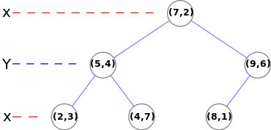
k-d Tree Graphical Representation
Points: (2,3), (5,4), (9,6), (4,7), (8,1), (7,2)
http://en.wikipedia.org/wiki/K-d_tree

Slide 26
kdTreeNode ConstructKdTree(List<Point> points){
if( points.isEmpty() )
return null;
kdTreeNode node = new kdTreeNode();
node.splitDim = selectAxis(points);
node.point = selectMedian(points, node.SplitDim);
points.Remove(node.point);
leftList, rightList = new List<Point>();
foreach(Point p in points){
if( p[splitDim] < node.point[splitDim] )
leftList.Add(p);
if( p[splitDim] > node.point[splitDim] )
rightList.Add(p);
else
randomly assign p to leftList or rightList
}
node.leftChild = ConstructKdTree(leftList);
node.rightChild = ConstructKdTree(rightList);
return node;
}

Slide 27
Split Dimension Selection Methods
Goal: Partition space into hypercubes
Deterministically cycle through each dimension
Split on a random dimension with equal probability
Spatial Median Splitting
Split on the longest dimension
Requires linear seek across all dimensions on every split

Slide 28
Median Selection Methods
Use median of medians algorithm to find median along splitDim in O(N) time
Use a heuristic to approximate the median in constant time
Median-of-three
Median-of-five
Ninther

Slide 29
Point QueryKdTree(KdTreeNode node, Point searchPoint, Point currBest){
if( node == null )
return currBest;
if( node.leftChild == null && node.rightChild == null )
return UpdateMax(node.point, searchPoint, currBest);
Bool searchDir = searchPoint[node.splitDim] < node.point[node.splitDim];
KdTreeNode searchFirst = searchDir ? node.leftChild : node.rightChild;
kdTreeNode searchSecond = searchDir ? node.leftChild : node.rightChild;
currBest = QueryKdTree(searchFirst, searchPoint, currBest);
currBest = UpdateMax(node.point, searchPoint, currBest);
if( HyperPlaneCheck(searchPoint, currBest, searchSecond) )
currBest = QueryKdTree(searchSecond, searchPoint, currBest);
return currBest;
}

Slide 30
Point UpdateMax(point, searchPoint, currBest){
if( currBest == null || dist(point, searchPoint) < dist(currBest, searchPoint) )
return point;
return currBest;
}
Boolean HyperPlaneCheck(Point searchPoint, Point currBest, KdTreeNode plane)
return dist(currBest, searchPoint) >=
abs(searchPoint[plane.splitDim] – plane.point[plane.splitDim]);
}

Slide 32
Modification of k-d Tree
Insertion
Search down the tree traveling to the half space the new point lies in.
Replace the first null node encountered with a new node containing the new point.
Choose a random split dimension for the new node
Lazy Deletion
Flag deleted node to not be searched against currBest
Continue to use that node to traverse to its subtrees

Slide 33
Modifications to k-d Tree Search
KNN
Apply a max heap containing K elements in the same manner as the linear search
Perform hyperplane pruning checks against the furthest element in the top K
Approximate Nearest Neighbors
Limit the maximum amount of allowed searches

Slide 34
Parallel Search
Due to randomness in median and split dimension selection, generated k-d trees will be different
Multiple k-d trees can be searched in parallel
Improves performance on points near early splits
Slightly hinders average performance
Important considerations:
Multiple trees should be searched in parallel not sequentially to allow for more pruning
The same heap must be used across each tree
A hash table should be used to track searched nodes

Slide 35
Modified Split Heuristics
k-d trees perform best with square regions
Distance metric takes into account linear transformation
Split probability matching (SPM)
Split proportional to the weight of dimensions in a DRV
Weighted spatial median splitting (WSMS)
Split on the longest dimension in the transformed space

Slide 36
Benchmark Method
Initial dataset 100,000 8-Dimensional points
Each dimension pulled from U(0,1)
Generate 100 random DRVs and 10 query points for each
Each entry in DRV pulled from U(0,1) and normalized
Compute result sets for all 1000 queries using linear search and each index being tested
Mean Percent Distance Gain (MPDG)
Average amount average distance in result set increases from linear search

Slide 39
5. System Description of Our Index

Slide 40
Our Index Basic Overview
Generates a large number of k-d trees with varying seed DRVs
Apply SPM or WSMS to select split dimensions for each k-d tree from its seed DRV
Heuristically select the best trees to search for each query
Search them in parallel

Slide 41
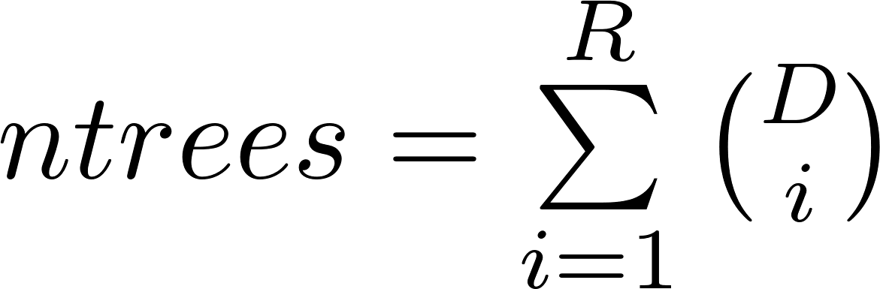
Distribution of Seed DRVs
Generate seed DRVs used to construct a large number of trees
Uniform DRV
Include uniform DRV, for case with no DRV specified
Random DRVs
Pull seed DRVs from uniform distribution
Deterministic DRVs
Include all subsets of up to R dimensions

Slide 42
Tree Quality Metric
Treat each seed DRV as a D dimensional vector
For each query, select top M (around 5 is optimal) trees with highest quality metrics

Slide 43
Selection of Top M Trees
Basic solution: perform a linear search on all seed DRVs against query DRV
Issue: Each computation of quality metric is equivalent to searching a node
Better solution: construct a k-d tree index on all seed DRVs
Perform an ANN query to determine the highest quality trees
Cuts down the cost of selecting best trees
Can control what percentage of seed DRVs are searched

Slide 44
Tree Elimination Heuristic
Purpose: Eliminate trees with a large disparity in quality in set of top M
Normalize the sum of tree qualities to 1
Eliminate all trees with normalized quality less than 1/(MP)
P: Tree pruning factor (around 2)
A tree with a very high quality (perfect or near perfect DRV match) will likely be normalized to ~1
All other trees will be pruned

Slide 45
Weighted Parallel Search
Search selected trees in parallel
Weight amount of nodes searched in each tree proportional to their qualities
Achieved by locking all trees in a master thread and using a weighted random number to determine which thread should search the next node

Slide 46
6. Performance Results

Slide 47
Test Conditions - Reminder
Initial dataset 100,000 8-Dimensional points
Each dimension pulled from U(0,1)
Generate 100 random DRVs and 10 query points for each
Each entry in DRV pulled from U(0,1) and normalized
Compute result sets for all 1000 queries using linear search and each index being tested
Mean Percent Distance Gain (MPDG)
Average amount average distance in result set increases from linear search

Slide 48
Query Parameters
K = 50
Max nodes searched = 500

Slide 49
Algorithm Parameters
Number of random trees: 100
R (deterministic dimension depth): 2
Percentage of seed DRVS searched: 40%
M (Number of trees to query): 3
P (Tree elimination parameter): 1.5

Slide 51
Extreme DRVs
Randomly select 1 dimension to be included
For each other dimension:
Determine whether or not it will be included with probability p
For each included dimension:
Select a weight from U(0,1)
Normalize sum of included dimensions to 1
Distribution of number of included dimensions:
Binomial(D-1,p) + 1

Slide 60
Corel Image Features Color Histogram Data Set
68040 images, condensed to 32 dimensions based on proportion of pixels in color ranges
Most dimensions are 0 or close to 0
With deterministic depth of 2 and 100 random trees, 629 total trees generated
Used p=.03 for extreme DRV test
80% of selected seed DRVs have 3 or less dimensions

Slide 63
7. Future Work

Slide 64
Further Heuristic Tuning
Split heuristic
Optimize split dimension selection given a seed DRV
Quality metric
Determine how well a tree will perform on a query given query a seed DRVs
Currently using scalar metric, could expand to vector

Slide 65
Real Time Optimization
Minimize memory cost
Use bit level keys instead of pointers
Optimize parallelization of multi-tree search
Use thread safe heap and hash table
Benchmark real time in a controlled environment

Slide 66
Distributed System
Implementation in a distributed environment
Store trees across different worker nodes
Augment tree quality metric with current load on node which holds each tree

Slide 67
Modeling and Adapting to User Behavior
Log all of the queries users make
Learn patterns in the types of DRVs queried
Apply this information towards more advanced seed DRV selection
Dynamically delete and create trees to better match queries being performed

Slide 68
Applications
Apply this algorithm to real world applications
Example: Movie recommendation
Reduce dimensionality of Tag Genome data set
Allow users to query for similar movies specifying weights on each feature

Slide 69
Questions?

